Slide 1
Late Night Sports Videos
General Assembly: Data Science Remote
Ben Ilfeld

Slide 2
The Problem
A regional sports network (Madison Square Garden Networks) is currently paying editors and analysts overtime after each game to produce same-day video analysis for their web properties. This overtime is costly and while some videos do gain lots of views, others do not.
What factors influence the popularity of these videos produced and published immediately after games?
Most importantly, at the end of the game, we aim to predict if it is worth keeping editors working overtime or let them go home.

Slide 3
“When” is critical to our prediction
Most games played in eastern time end
Editing team can post new videos without paying overtime
1:00am
10:00pm
9:00am
Most games played in pacific time end
We must include post game videos watched during this period
This includes videos watched the same night as the game was played, but also videos watched early in the morning the day after the game was played

Slide 4
Hypothesis
Web data analysts have noted anecdotal evidence that when the team loses a game, there are lower video plays after the game.
In addition to this factor, we considered:
Net team record (wins - losses)
Net score (team score - opponent score)
Did the game to into overtime?
Did the team lose the previous game?
The quality of the opponent
The start time of the game

Slide 5
Describing the Data
Per Video
We considered each video posted and attempted to predict what factors led to increased views on a per video basis. We had data about 769 videos and up to 20 features.

Slide 6
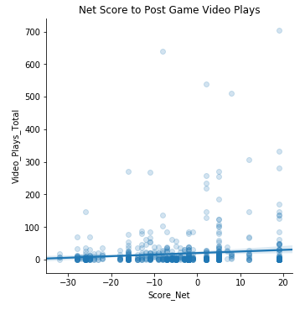
Per Video
On the per video analysis, a bug in web analytics capture tainted important factors which described the videos (e.g. video category, on screen personalities)
Linear and Random Forest Regressions were making predictions only marginally better than guessing the mean value.
But importantly we did see there were some weak relationships to explore. For example, the net score of the game shows correlation to plays:
Weak relationships and tainted data

Slide 7
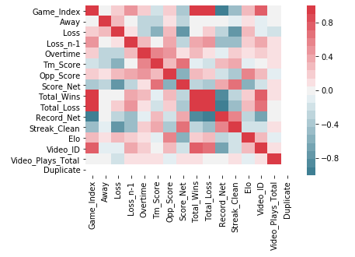
Per Video
However overall, relationships were weak on a per video basis.
Weak relationships and tainted data

Slide 8
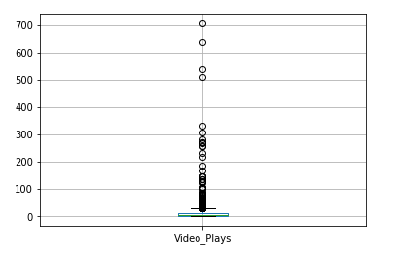
Lots of Videos With One Play
One of the clear issues is that many of these videos simply aren’t viewed very much at all the night after a game.
Below, note that almost all the videos above one view are considered outliers in a box plot:

Slide 9
Solution: Move to Per Game Analysis
Per Game
We aggregated data per game and attempted to predict how many video views resulted from the total post game effort of the editorial team. This left us with 46 observations from the first half of the season.

Slide 10
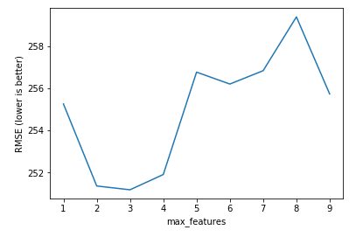
Models and Approach
We tried these models:
Linear regression with more / fewer features
Linear regression with polynomial features
Random forest regression with different numbers of maximum features
Scoring
With this relatively small set of data, we used 10 fold KFold analysis to score the model
We used RMSE against a null prediction using the mean of the videos plays by game
Best model:
Random forest with 8 total features and tuned with a maximum number of 3 features per tree worked best

Slide 11
Per Game Results
The null prediction RMSE to beat was
381 views
On our tuned Random Forest, the RMSE of the KFold split was:
258 views
So our model is now significantly outperforming our uninformed guess.
Accuracy

Slide 12
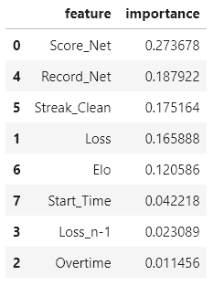
Per Game Results
The most important feature was indeed net score, but it was not the only key factor.
The overall record, win streaks and the quality of the opponent also played a large role.
Feature Importance

Slide 13
Next Steps
We've gotten to a good place with the data we have, but it would make sense to make two improvements going forward:
We'd like to go back to the analysis by video and determine if tainted features can be corrected and added back. I'd love to answer the question: if we are going to edit video tonight, what kind of videos are most likely to be viewed?
We'd like to add last year's data to the "per game" analysis. This data from last year was structured differently and will require additional clean-up, but less than on the granular video-by-video analysis.

